Slide 1
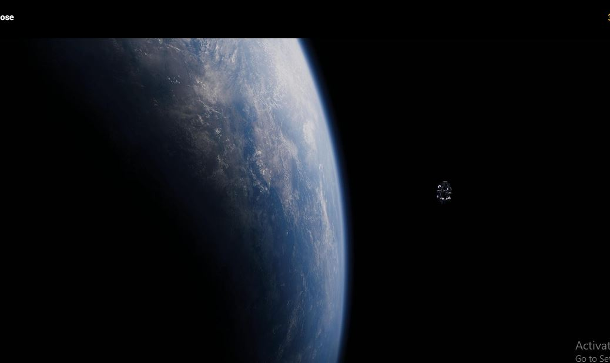

Spaceship Titanic
Project
Umar Farooque

Slide 2
Project Description:
Year : 2912
Spaceship Titanic, an interstellar Passenger liner, launched with around 8000 passengers, transporting them to three habitable exoPlanets orbiting nearby stars.
While rounding Alpha Century, collided with a hidden Space Time Anomaly. Unfortunately few passengers got transported to different dimension of time and space.
Some Data of passengers has been retrieved from the damaged ship as the signal from ship remained intact to Earth.
Task:
Data Science Team has to predict which passenger got transported based on data retrieved to send crew on mission to search lost passengers.

Slide 3
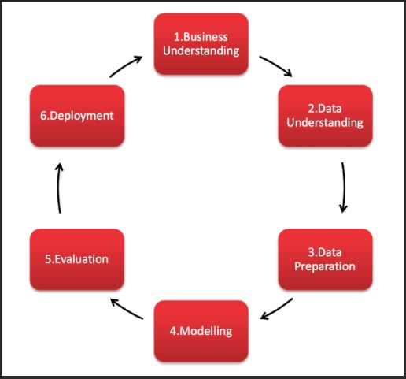
CRISP-DM
Cross Industry Standard Process for Data Mining
Business Understanding
Data Understanding
Data Mining
Modelling
Evaluation
Deployment

Slide 4
Understanding Dataset
PassengerId - A unique Id for each passenger. Form gggg_pp where gggg :- group the passenger is travelling with & pp :- number within the group. People in a group are often family members, but not always.
HomePlanet - The planet the passenger departed from, typically their planet of permanent residence.
CryoSleep - Indicates whether the passenger elected to be put into suspended animation for the duration of the voyage.
Cabin - The cabin where the passenger is staying. Takes the form deck/num/side, where side can be either P for Port or S for Starboard.
Destination - The planet the passenger will be debarking to.
Age - The age of the passenger.
VIP - Whether the passenger has paid for special VIP service during the voyage.
RoomService, FoodCourt, ShoppingMall, Spa, VRDeck - Biilled amount of passengers for many luxury amenities.
Name - The first and last names of the passenger.
Transported - Whether the passenger was transported to another dimension.

Slide 5
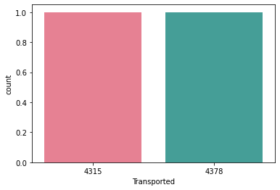
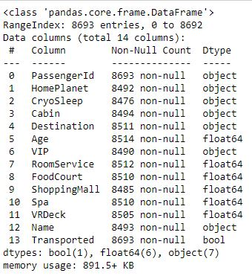
Dataset
Our Target feature is balanced

Slide 6
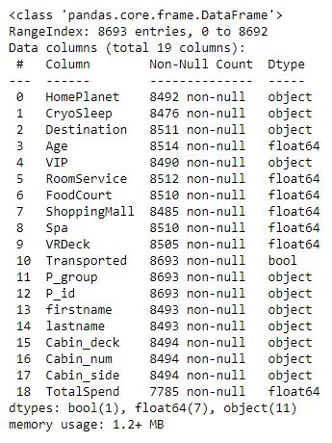
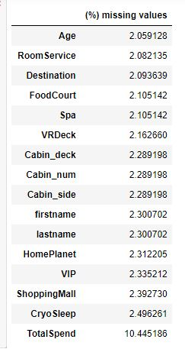
Exploratory Data Analysis
Splitting mixed data type
Features for better analysis.
Notes:
Hello everyone!

Slide 7
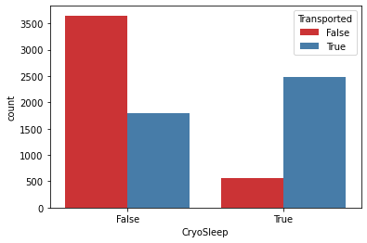
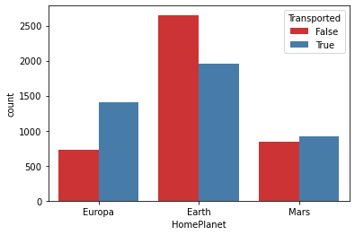
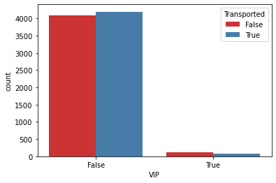
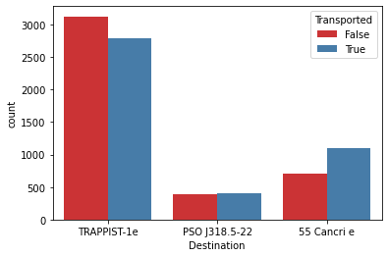
Univariate Analysis

Slide 8
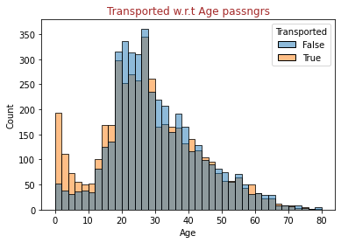
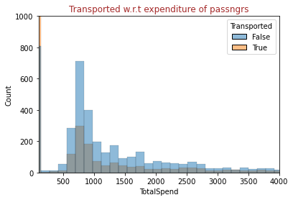
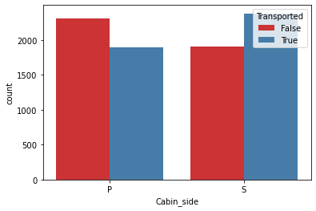
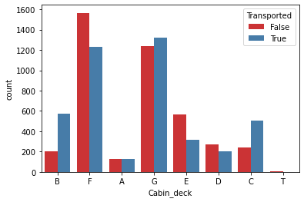

Slide 9
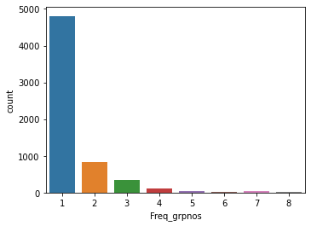
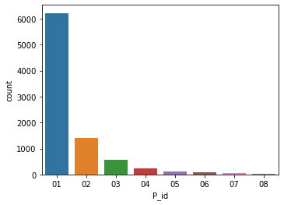
PassengerID : Passengr_group + Passngr_id
Most of Passengers are alone (Having single P_id for its Passngr_group.
Max 8 passngr_id in any P_group.

Slide 10
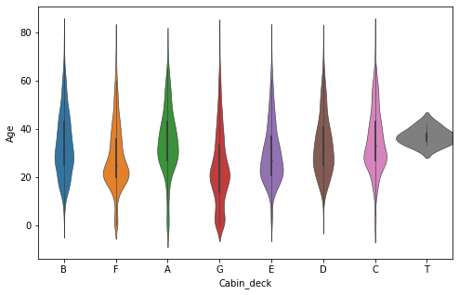
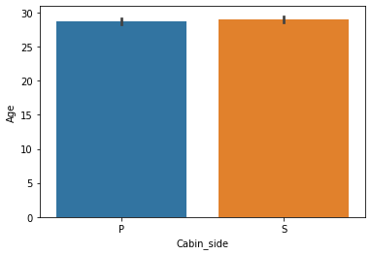
On deck'A' most passngers are of age (25,35) while on deck'G' we have many kids of age around 10,
Although most decks has passengrs of all age group except deck'T
Cabin deck

Slide 11
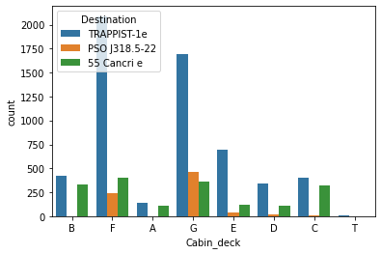
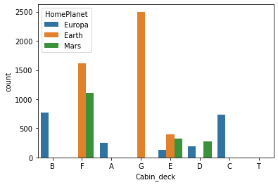
Deck and side

Slide 12
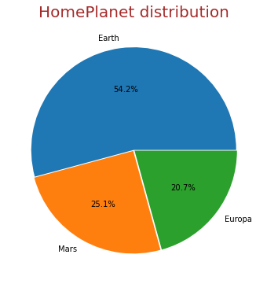
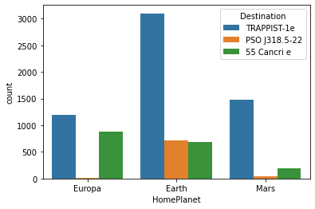

Slide 13
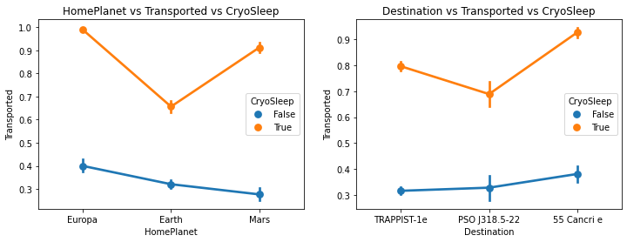
Passengers in suspended animation were Transported more irrespective of their homeplanet or destination.
Homeplanet Earth and Destination PSOj318.5-22 has least passengers transported.

Slide 14
Data Preprocessing
Filing Missing Values
Passengers of same group belong same CABIN, HOMEPLANET and has same financial status(VIP).
Fillna using groupby method
Encoding features (dummy variables)
Total features: 24
Splitting Dataset : (70:30)
Train Set: 6085 rows
Test Set: 2608 rows
Scaling numerical features

Slide 15
Model Building
Model Performance without Optimization: Evaluating Model
- Based on accuracy scores the Ensembling techniques seems to be
Performing good
Logistic Regression : 78% -Steps to Optimize the model performace
K-Nearest Neighbours : 76% - Hyper Parameter Optimization using :
Decision Tree : 77% 1) Elbow Method
Random Forest : 79% 2) Grid Search CV
AdaBoost : 79% - Applying Cross Validation to check final performance on unseen data
Hist Gradient Boosting : 81% Let’s start!

Slide 16
Optimized Model
 | Optimized Model Accuracy | Cross Validation Accuracy
Random Forest | 80% | 79%
AdaBoost Classifier | 80% | 80%
HistGradientBoosting | 81% | 80%

Slide 17
Adaptive Boosting method is making more robust model for this dataset as of now.
The model has no significant sign of overfitting, i.e it’s a desired generalized model which is ready for any unseen data.
Suggested algorithm :
Applying more Boosting methods
Finally Neural Networks can work well.

Slide 18
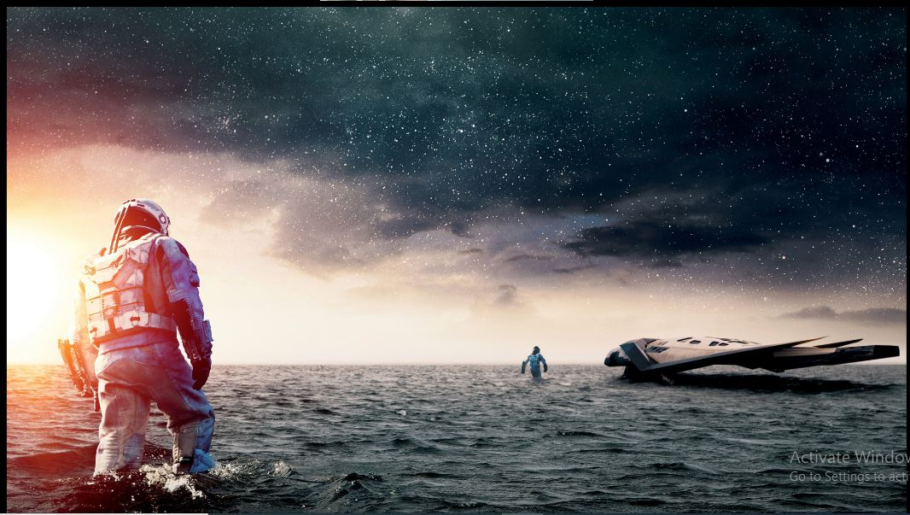
Caz every single Human matters
Notes:
Now that we have details of our lost ones. Our finest Pilot’s Murphy Cooper is ready with the crew. let’s launch the Mission

Slide 19
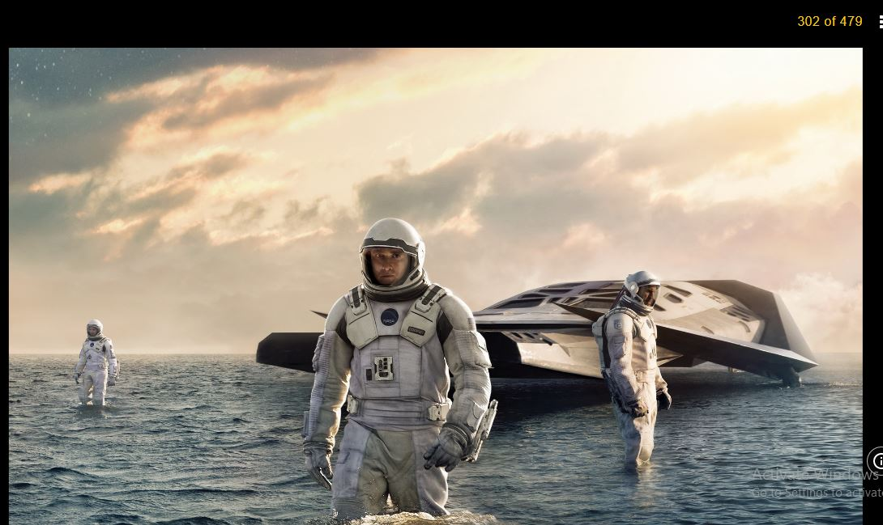

Slide 20
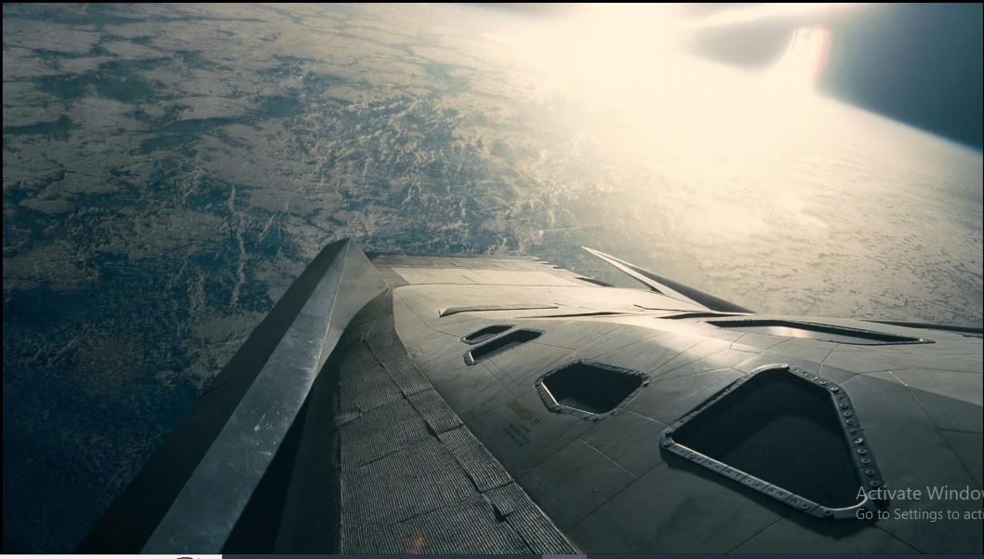

Slide 21
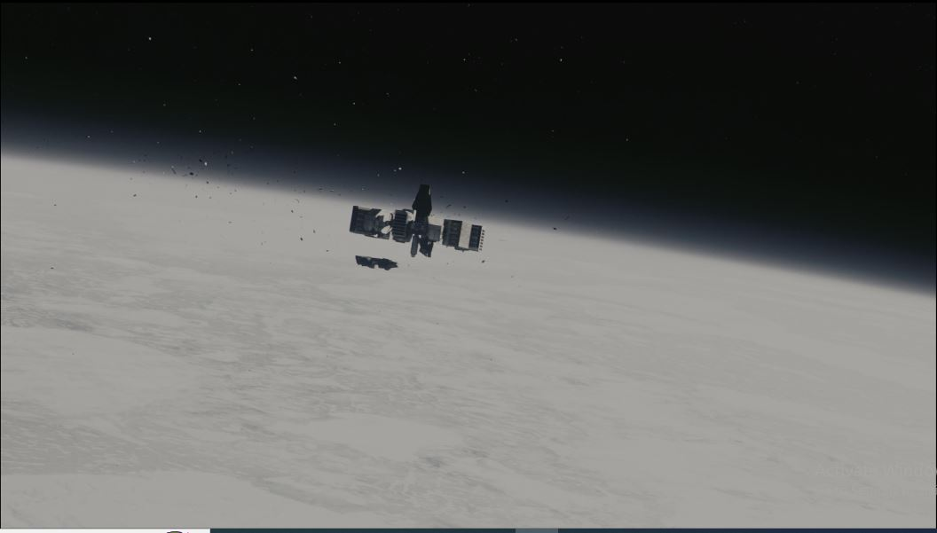

Slide 22
